Slide 1
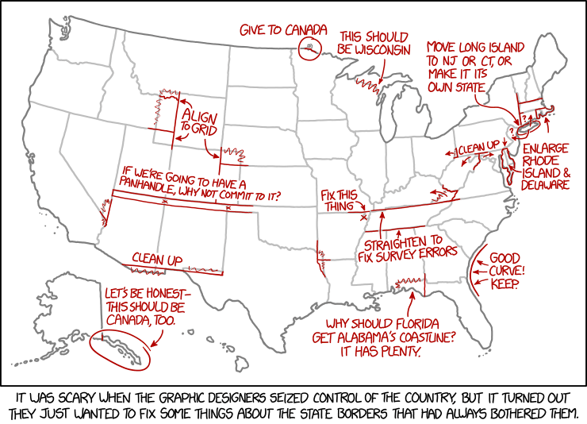
User interface design
xkcd

Slide 2
UI Design: Week 3, Friday
Dr. Jillian Aurisano
Plan for today:
Announcements/Course logistics
Design choices - simplicity
Notes:
So welcome to engineering visual interfaces for data science. I'm Dr Aurisano.
Thanks for finding the class on Zoom. Hopefully we will be in person again soon.
If anyone out there is comfortable turning on their cameras, that is lovely- then I feel like I am talking to students, rather than to myself.
Here’s our plan for today:
First I’m going to introduce myself, so you know a bit about me
Then we are going to get to know each other, in Zoom breakout rooms. This will give us a chance to make sure that Zoom breakout rooms work, and we all know how to access them.
Then, I am going to walk through the structure, and plan for the course. I want to make sure everyone knows how the course will work, and what to expect, and also a bit about why the course is designed this way.
Then I am going to introduce the class, and what the class is about. Since this is a new class, and one of just a few classes in human centered computing here at UC, I wanted to give an overview of the topic.
Then I have an introductory activity, which we will do in breakout rooms, and which I think will help motivate the discussion on Wednesday, and getting into the meat of the class.

Slide 3
Recap-
People ideally learn a UI by doing something with it
You can design to make it easier for someone to discover capabilities of UI
Affordances, Signfiers, Constraints, Mappings, Feedback, Consistency

Slide 4
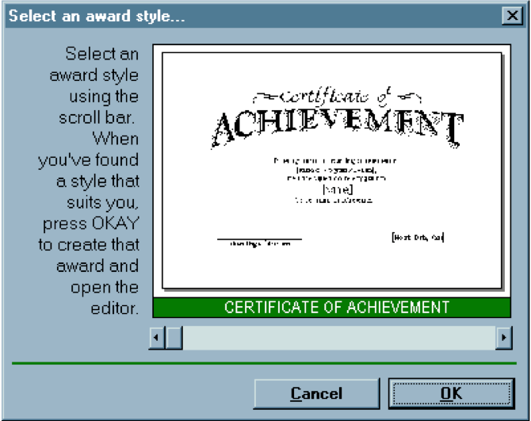
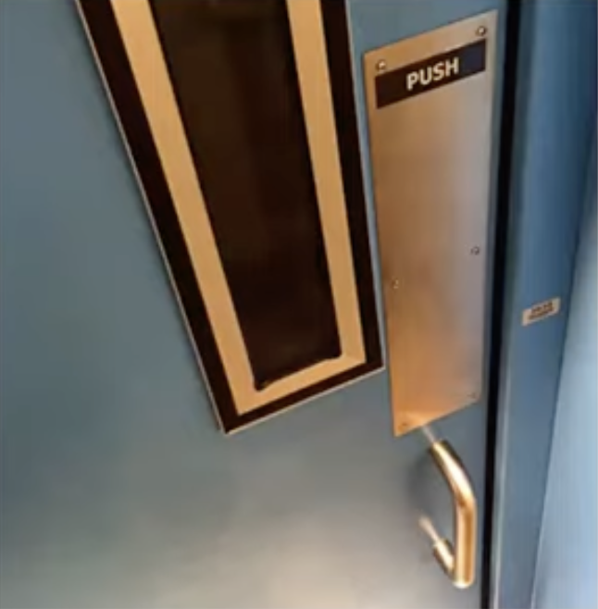
Recap- Affordances
Handle affords grabbing
and pulling
Slider bar affords
continuous movement
Good for continuous
navigation

Slide 5
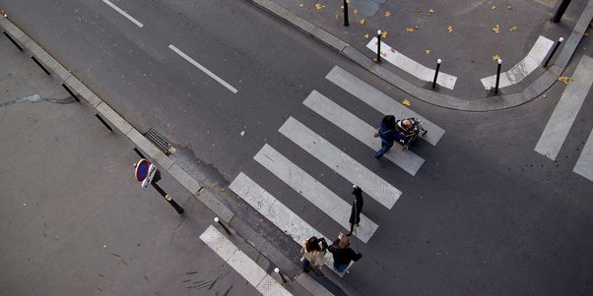
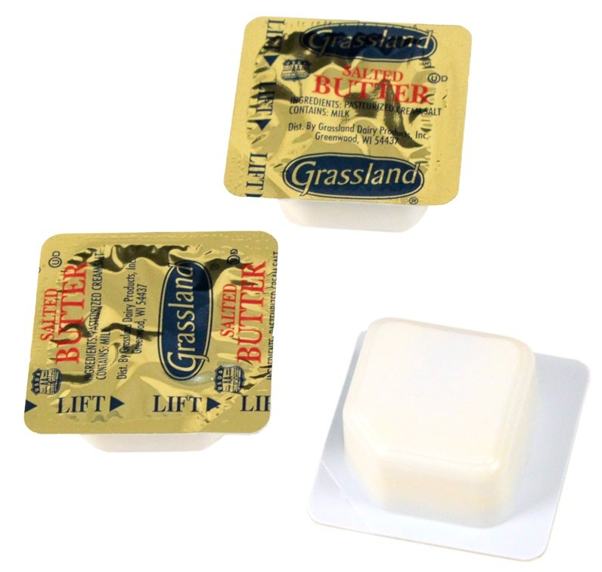
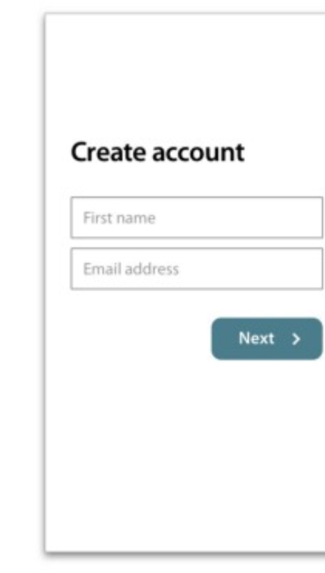
Recap- Signifiers
Cue: walk here
Cue: lift here
Cue: click here, it will take you to the next page

Slide 6
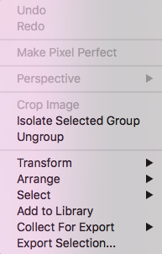
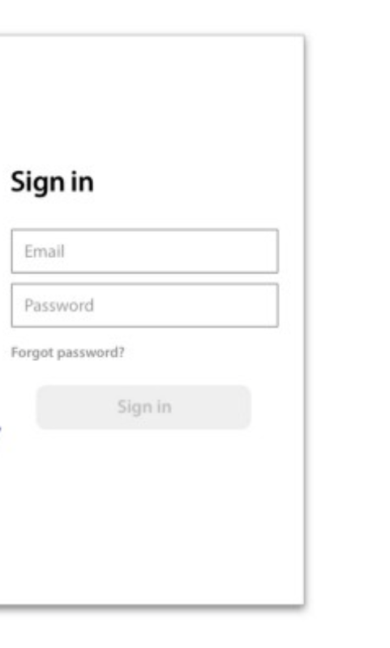
Recap- Constraints
Constraint- you can’t click yet
Constraint- some features not available here

Slide 7
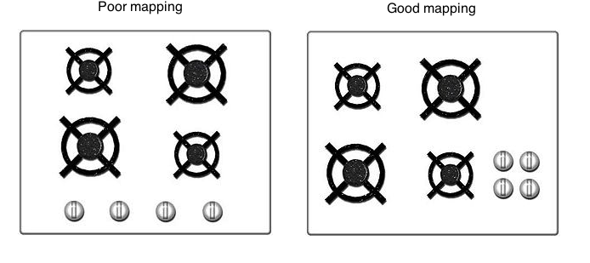
Recap- Mappings
Buttons are in positions that relate to the thing they control

Slide 8
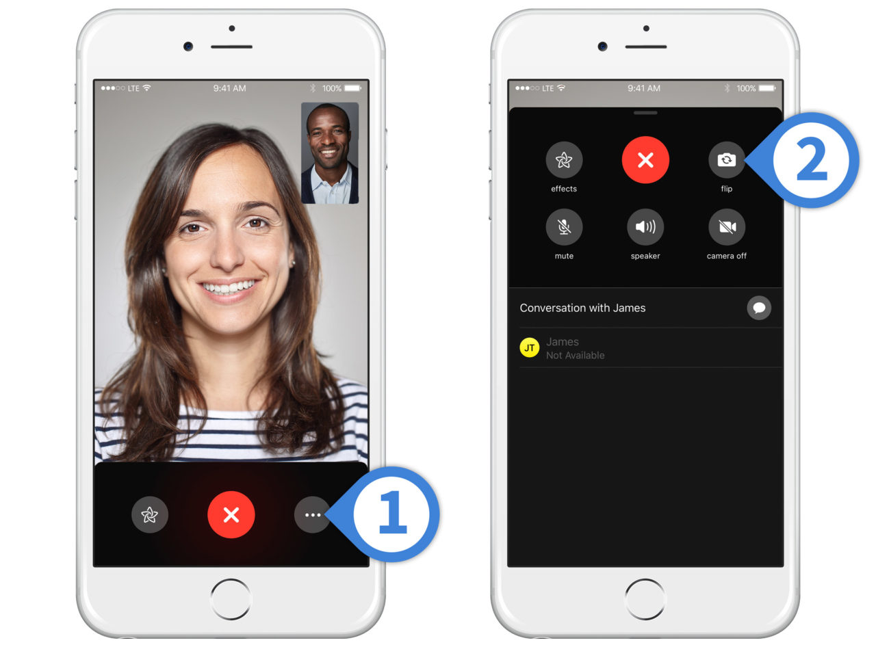
Feedback
Actions -> Rapid Feedback

Slide 9
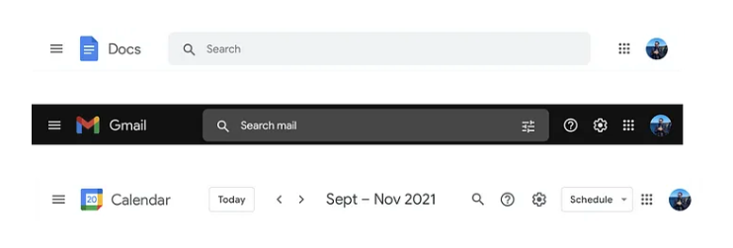
Recap- Consistency

Slide 10
Design
Simplicity
Gestalt Principles (Monday)
Visual design- use of space (Monday
Grouping and Hierarchy
Balance and Symmetry
Alignment and Grids
Color (Wednesday)

Slide 11
Simplicity
What is simplicity in a design?
Why is it good?

Slide 12
Simplicity
What is simplicity in a design?
Why is it good?
Nothing more to add
Nothing left to take away

Slide 13
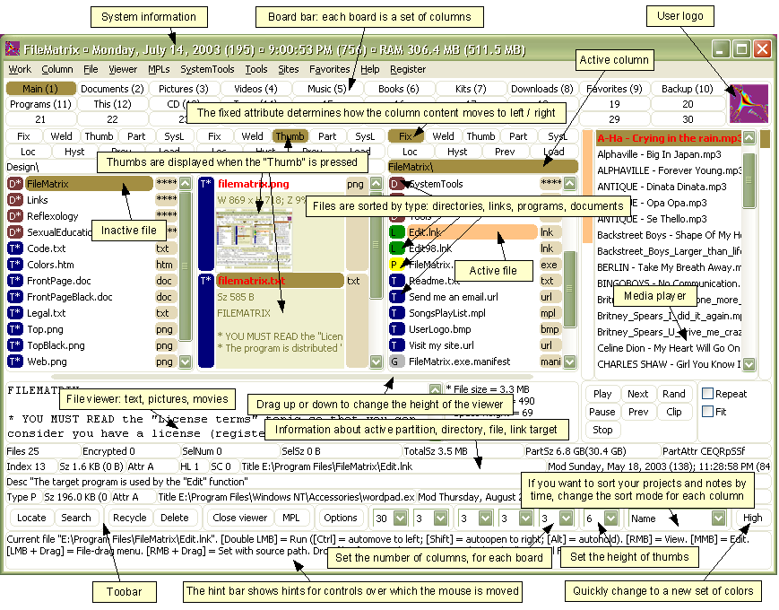
Simplicity- counter-example
File Matrix program
Complexity interferes with usability
Less learnable (hard to learn to use)
Less efficient (hard to find features quickly)
Less safe (easy to click the wrong place)

Slide 14
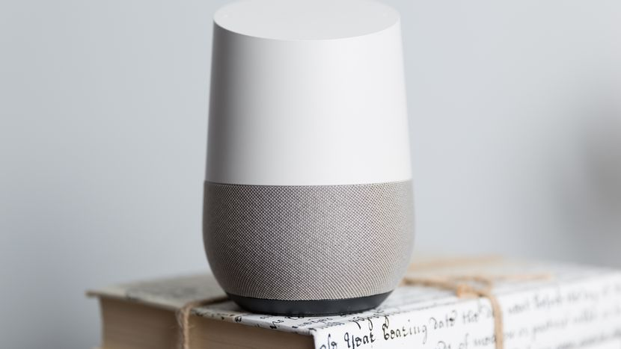
Simplicity
Compare to this Google home device

Slide 15
Simplicity is hard
Simplicity is in tension with our impulse to add more features and elements ‘just in case’
Simplicity forces you to have a good reason for everything you add, and to take away anything that can’t survive hard scrutiny

Slide 16
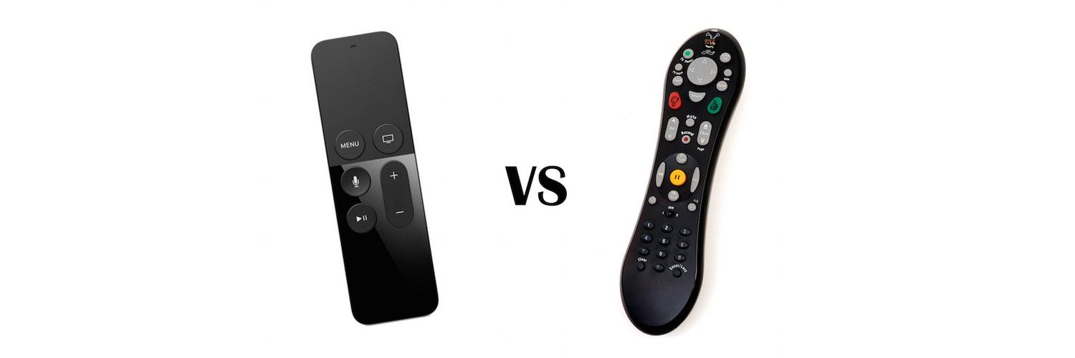
How to achieve simplicity: One approach: Reduction
Reduction:
Remove inessential elements
Remove inessential features
Even if it seems essential, try removing it anyway, to see if the design falls apart.

Slide 17
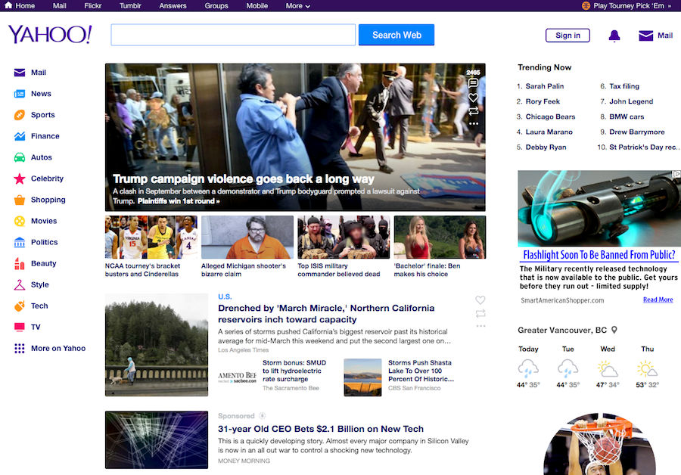
Reduction- understand your user’s main goal
Yahoo vs Google
Yahoo- what is included on main page?

Slide 18
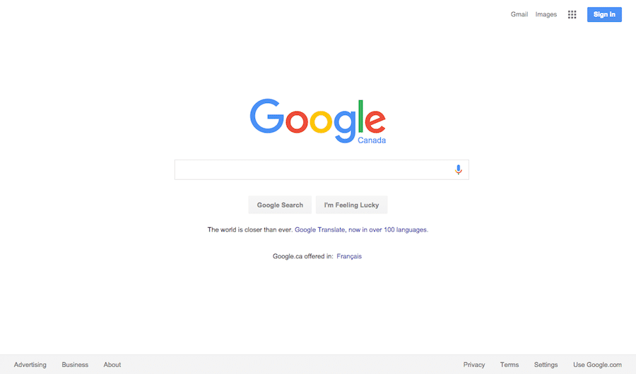
Reduction- understand your user’s main goal
Yahoo vs Google
What is on Google’s main page?

Slide 19
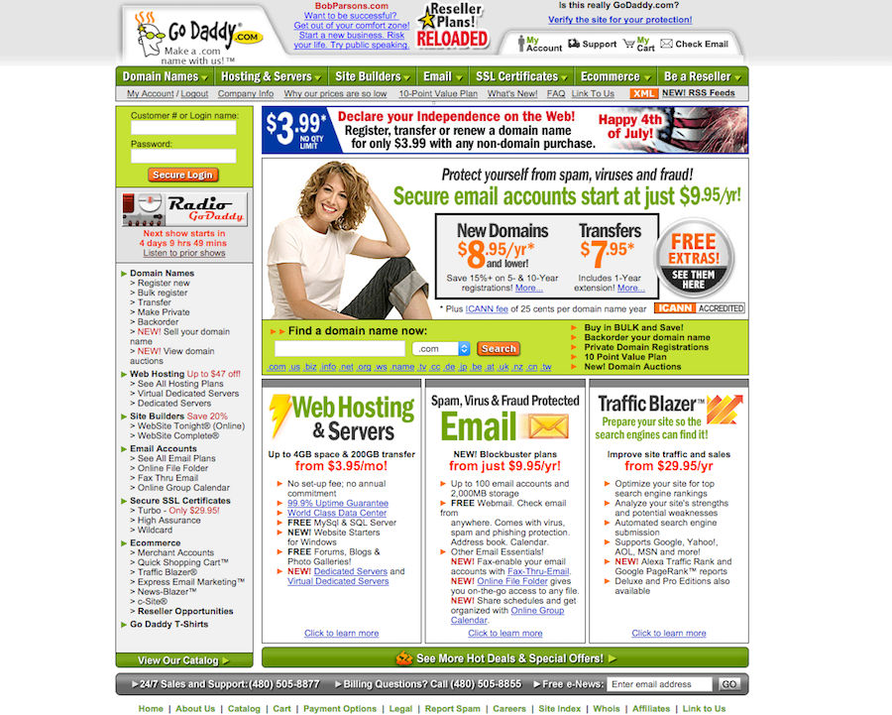
Reduction- another example
GoDaddy 2005 vs 2016

Slide 20
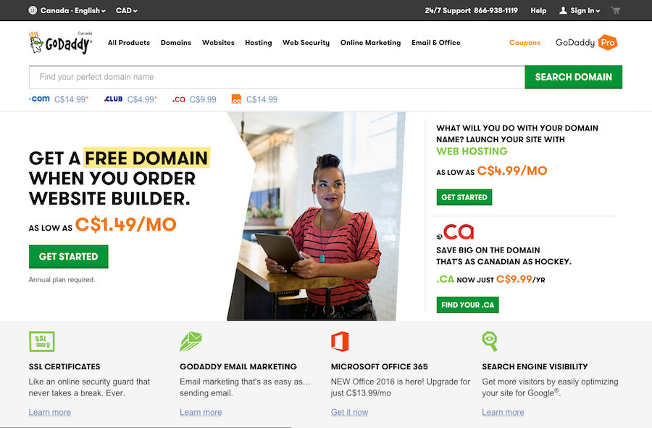
Reduction- another example
GoDaddy 2005 vs 2016

Slide 21
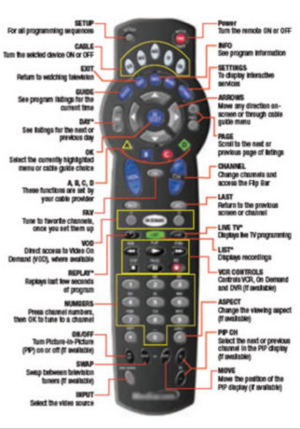
Return to the remote- how did it get this way?
Remotes evolved from the previous version
Always adding new buttons
Never taking away
Designed to operate without a visual interface on the screen
Everything needed a button
Designed for engineering simplicity, not usability
Easy to connect these buttons to operations in the TV

Slide 22
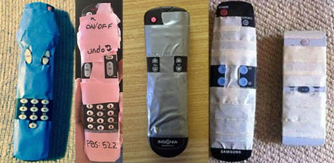
Remote- fixed!
Reddit

Slide 23
How to achieve simplicity: Regularity
Regularity: minimize the unnecessary differences
Use the same font, color, line width, dimensions, orientation for multiple elements
Irregularities in your design will be magnified in the user’s eyes and assigned meaning and significance.
Use a regular pattern
Limit inessential variation among elements

Slide 24
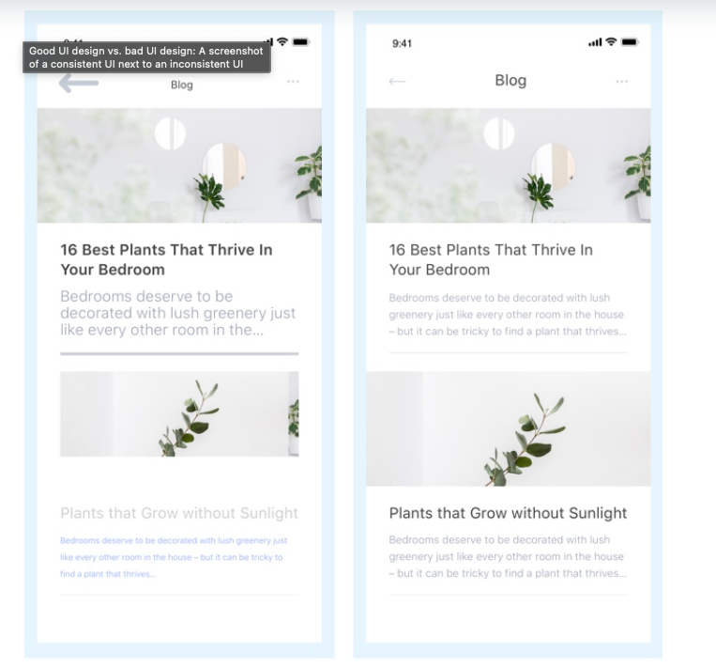
Which one of these violates regularity?
https://careerfoundry.com/en/blog/ui-design/common-ui-design-mistakes/

Slide 25
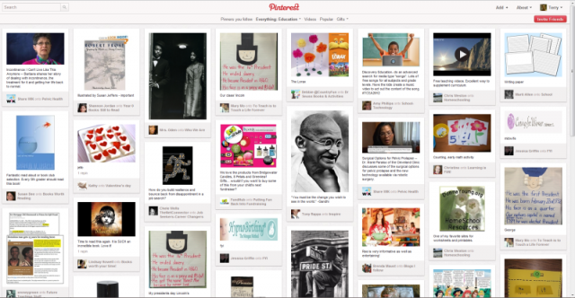
Regularity example: Pinterest regular column widths

Slide 26
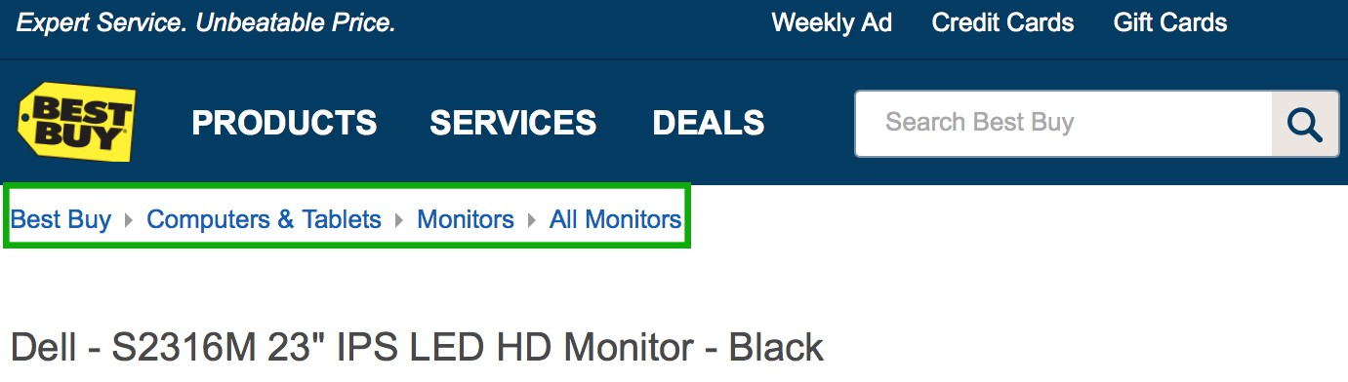
How to achieve simplicity: Double Duty
Try to combine elements to make them serve multiple roles in the design.
Example: a window’s title bar plays several roles
label, dragging handle, window activation indicator, and location for window control buttons.
The breadcrumbs pattern and the pagination pattern also do double duty

Slide 27
But can simplicity go too far?
Can anyone think of something they have used that is trying to be so simple, it is probably too simple?

Slide 28
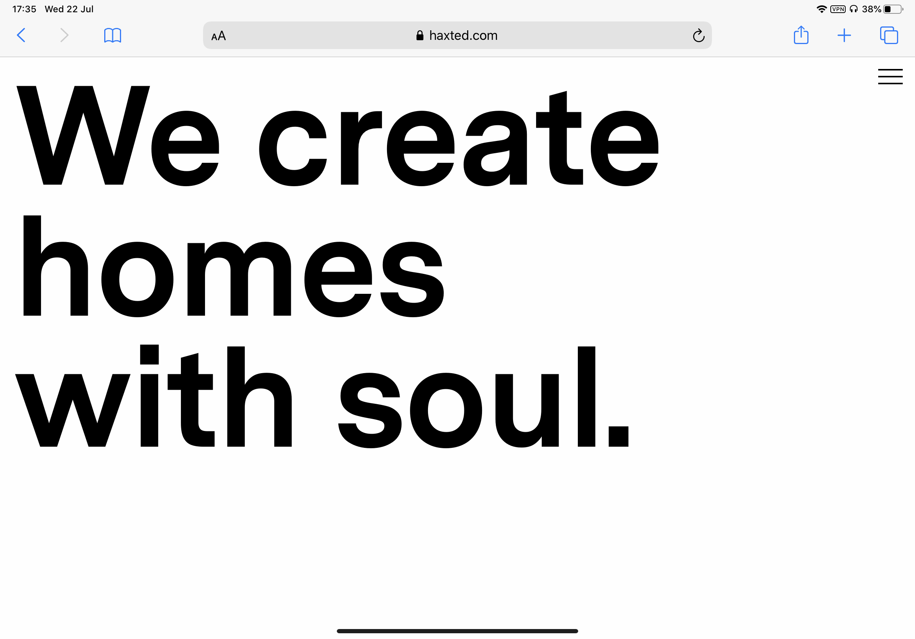
Example- overuse of hamburger menu
Why a hamburger menu (three lines, upper right) here on this desktop site?
Well maybe there are lots of links?

Slide 29
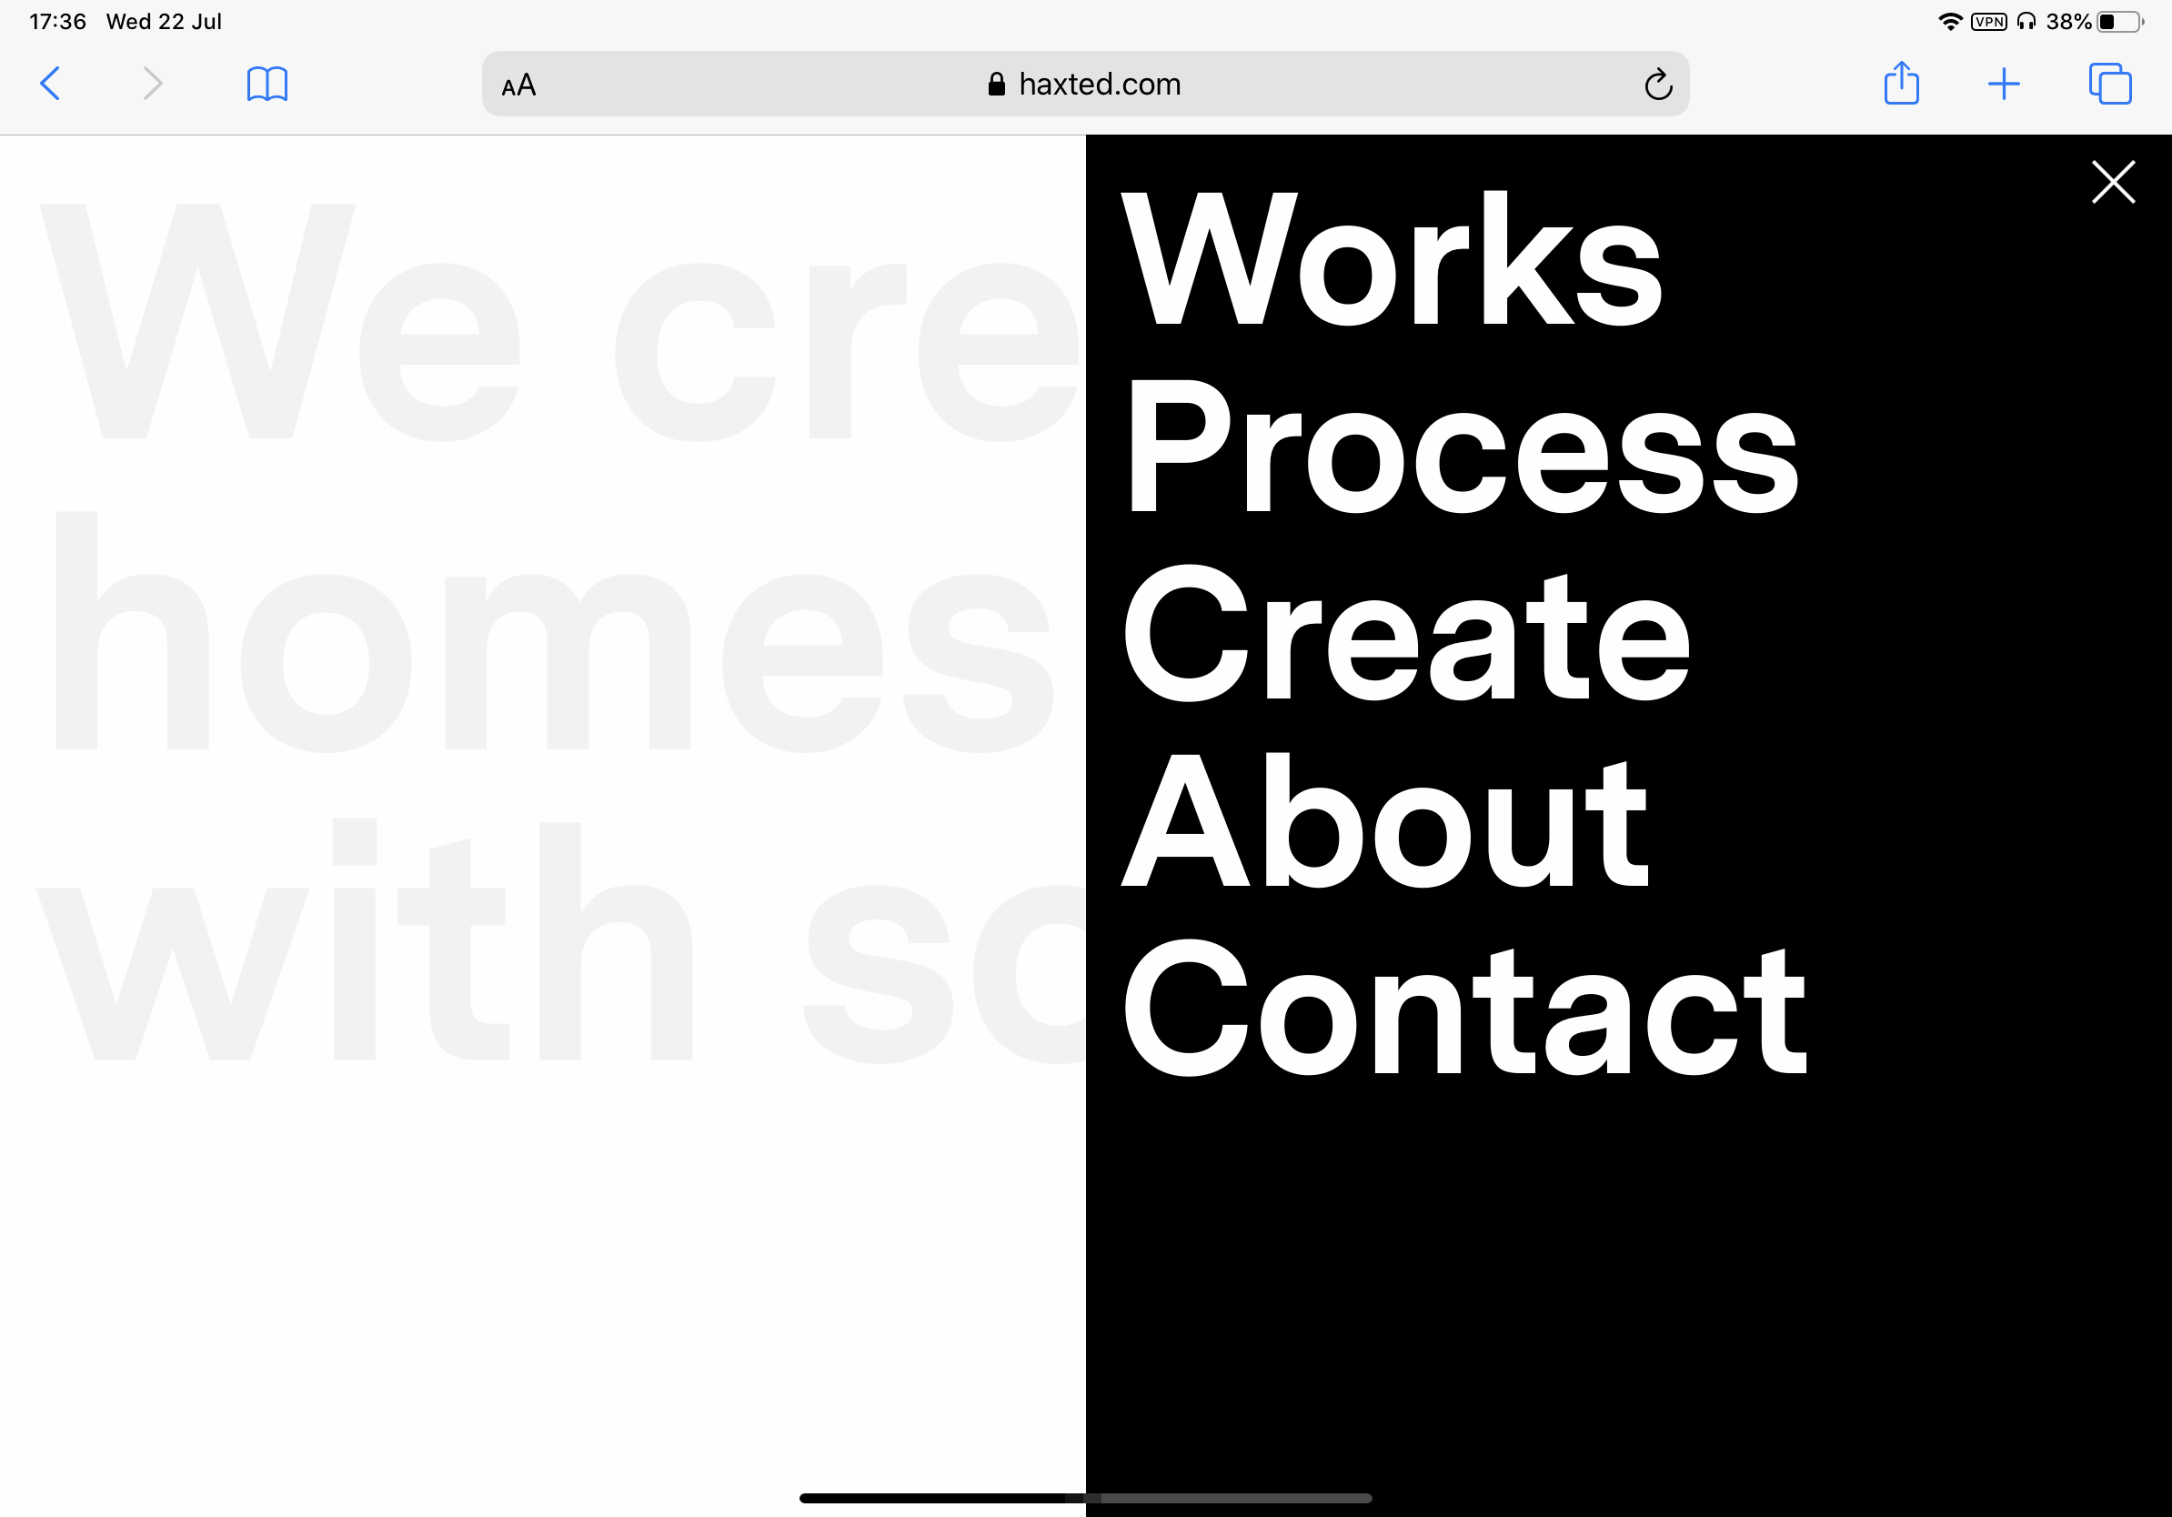
Example- overuse of hamburger menu
Too many links?
No just 5
Is this just a funny example of minimalism gone too far?

Slide 30
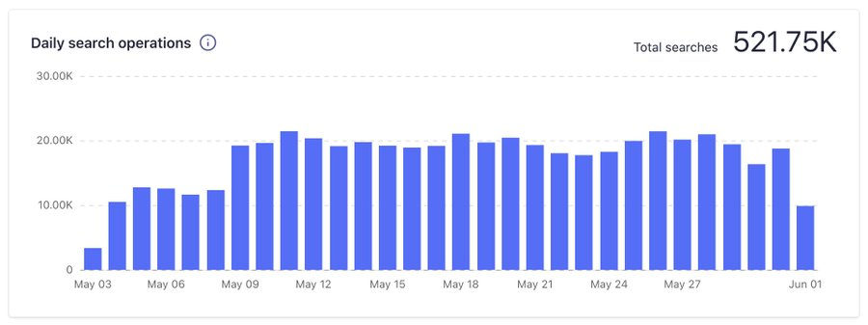
The problem with hidden features
Example- a website (Smashing Magazine) moved the search button from a hidden position under ‘menu’, to displaying it at all times
Result: 80% increase in searches

Slide 31
Icons without labels
Study
For icons with labels users were able to correctly predict what would happen when they clicked them 88% of the time
Icons without labels, this number dropped to 60%
For icons that are unlabeled and unique to the app (not used in other apps) this dropped to 34%

Slide 32
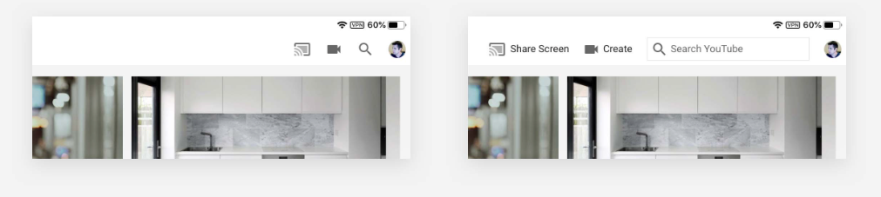
Which do we prefer- labels or none?
Youtube Ipad app
There is room for labels, maybe we should use them?

Slide 33
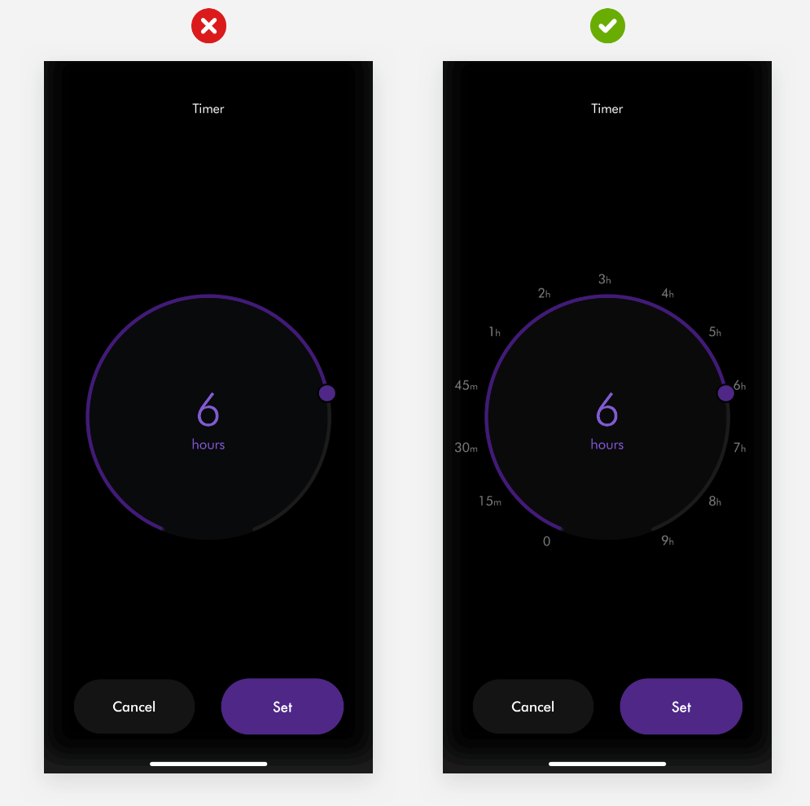
Which do we prefer- timer app

Slide 34
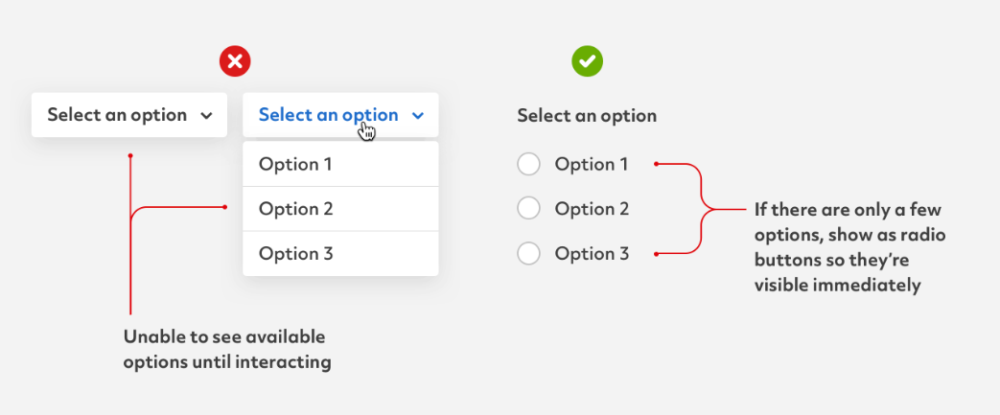
Drop downs vs visible menu
More minimal
But more clicks to
get to buttons

Slide 35
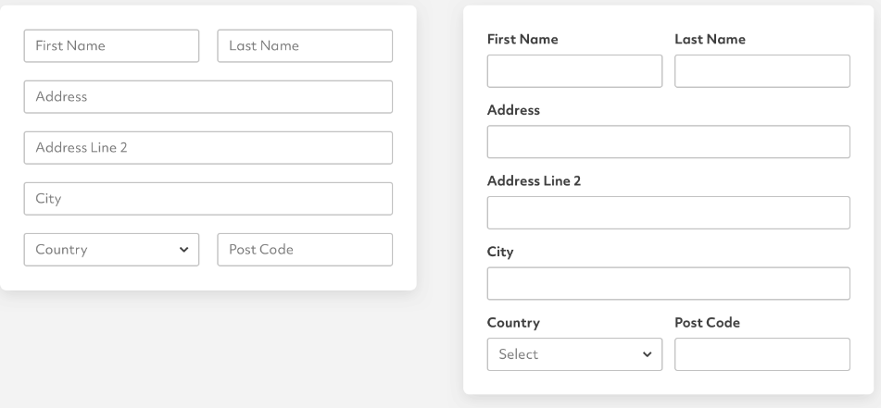
Which do we prefer?
Trade-offs
What can go wrong with the option on the left?
But the option on the right takes up more space….

Slide 36
Which do we prefer?

Slide 37
So how can we handle all the features we have
Simplicity is in tension with having a robust application with lots of features
How can this be addressed?

Slide 38
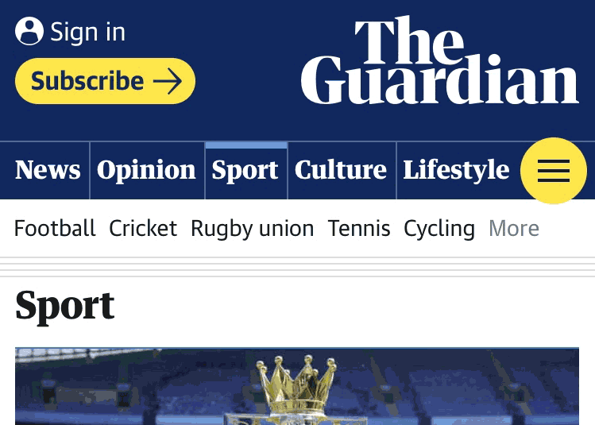
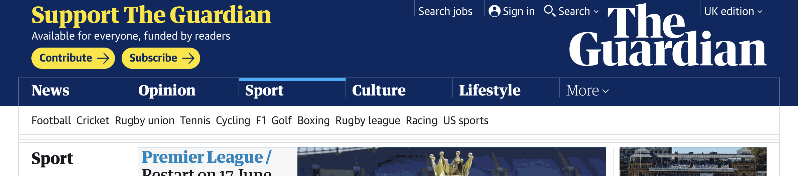
Let’s look at news websites
News websites have LOTS of information
How do they manage?
One approach: menus
Prioritized set of news content at the top
Hamburger menu for everything else
Or ‘more’ menu

Slide 39
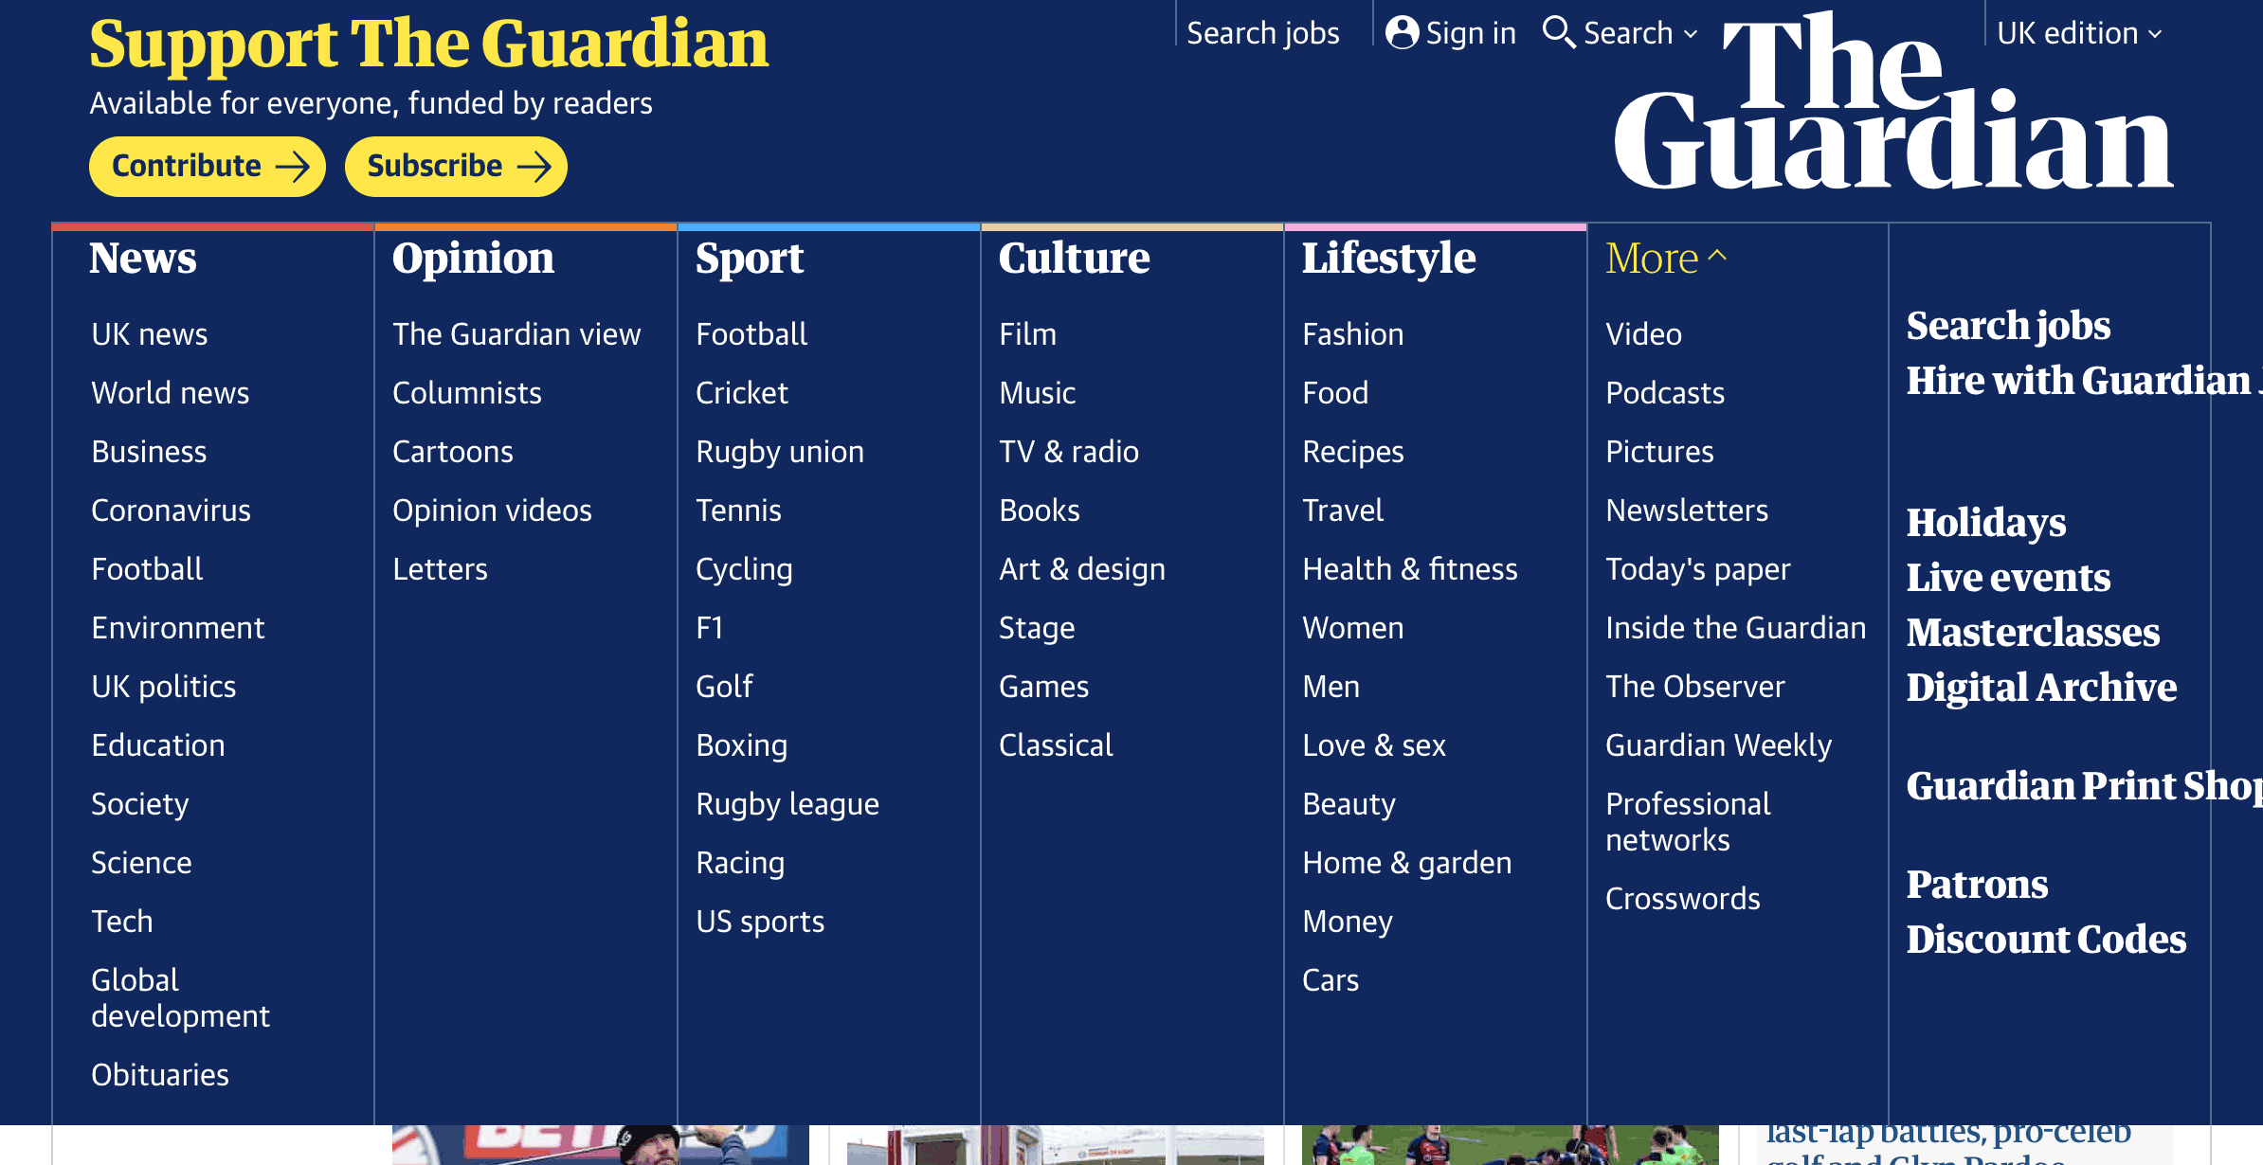
Menu

Slide 40
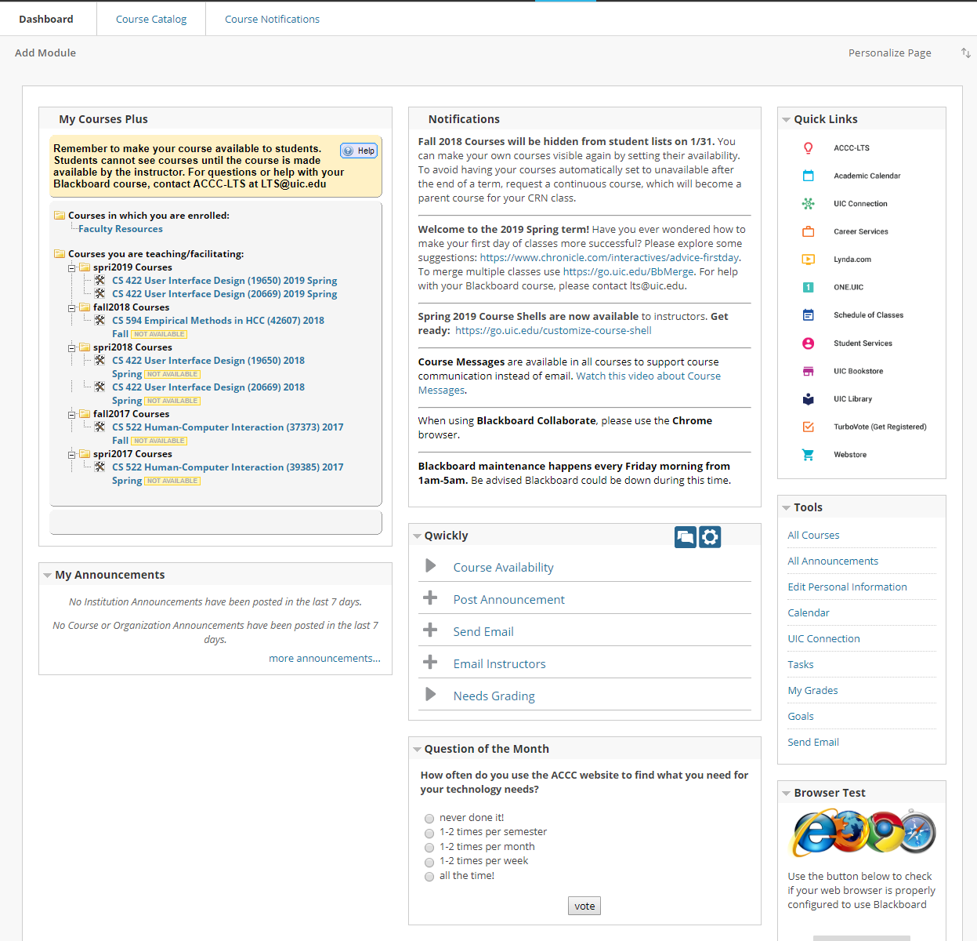
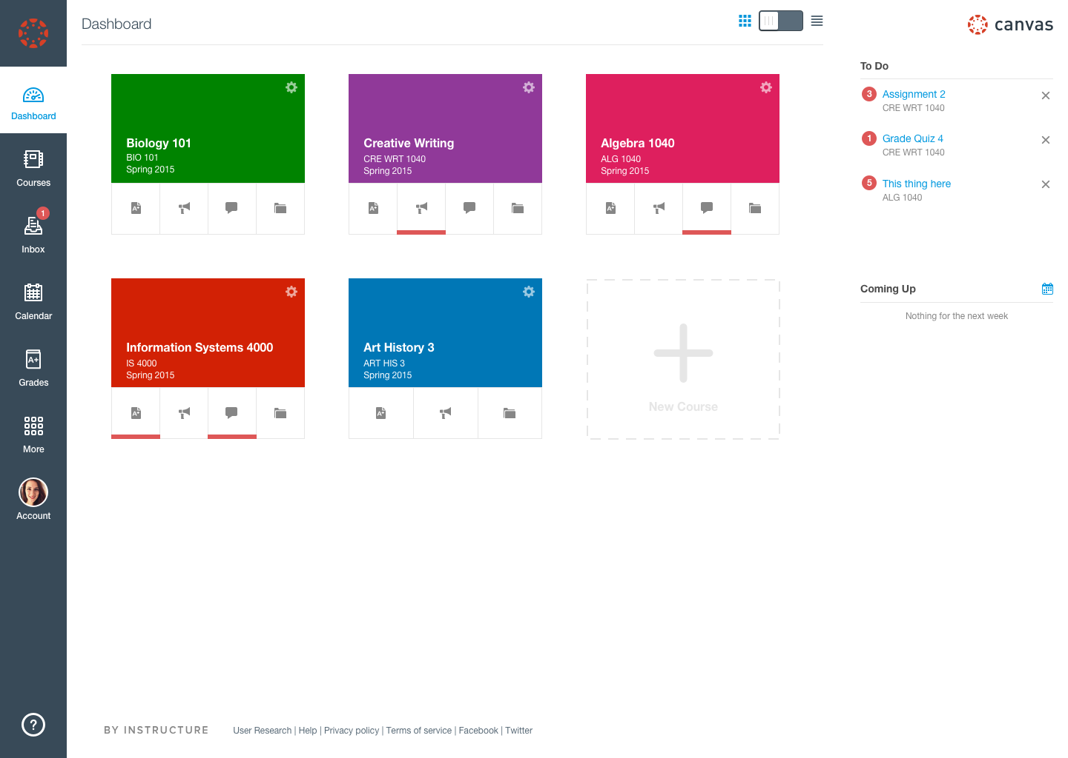

Slide 41
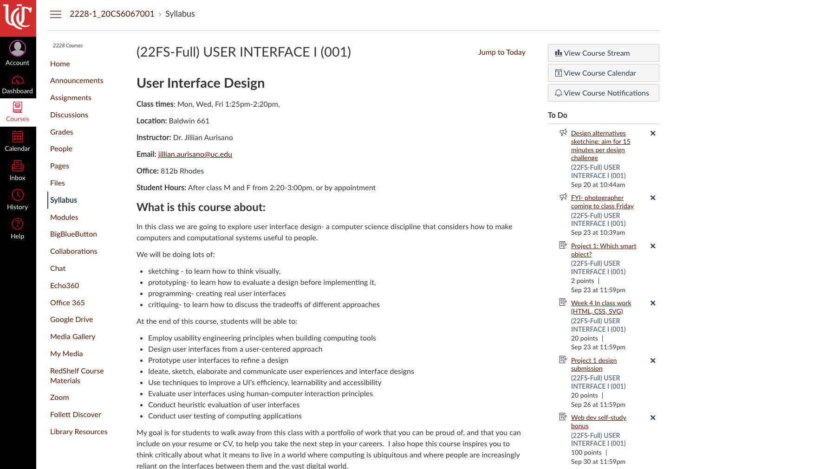
Let’s try to make a complex page, more simple
Canvas
Canvas has lots of features
I have used very few of them
What about you?
Can you make it simpler?
Reduce
What is the core function of Canvas for you and your group?

Slide 42
Slide credits
Debaleena Chattopdhay
https://www.toptal.com/designers/ui/gestalt-principles-of-design#:~:text=There%20are%20six%20individual%20principles,gestalt%2C%20such%20as%20common%20fate.
https://balsamiq.com/learn/articles/visual-hierarchy-and-alignment/
https://www.interaction-design.org/literature/article/simplicity-in-design-4-ways-to-achieve-simplicity-in-your-designs
https://tomkenny.design/articles/false-simplicity

